Slide 1
URBAN APPAREL
BY:
Abbad Hasan 24k-0600,
Fawwaz Adil 24k-0610,
Nasrullah Babar 24k-0990

Slide 2
INTRODUCTION
Urban Apparel Overview:
A modern e-commerce platform for trendy clothing.
Project Description:
Developed a fully functional clothing apparel website.
Built using HTML, CSS, and JavaScript.
Primary Goal:
Create a user-friendly online platform for showcasing and selling clothing items.
Key Features:
Seamless shopping experience.
Browse products, add items to the cart, and complete purchases.

Slide 3
Structure and Flow of the Webpage
Key structural elements of the website

Slide 4
Webpage Overview
Home (index.html):
Landing page featuring an image carousel and product highlights.
Products (products.html):
Displays a collection of products with filtering options and categories.
Checkout (checkout.html):
Collects user details and payment information.
Shows cart details for review before completing the purchase.

Slide 5
Home Page Structure
Header Section:
Includes the navigation menu and logo.
Features a sidebar for additional links and a cart button.
Main Content:
Carousel: Displays promotional banners with images.
Banners Container: Highlights collections or offers with clickable links.
Dynamic Product Section:
Product filters by categories like shirts, pants, and hoodies.
Products are dynamically rendered using JavaScript.
Contact Form:
Allows users to submit inquiries via name, email, and message fields.
Cart Sidebar:
Displays cart items and total price.
Includes a checkout button and a clear cart option.
Footer:
Contains copyright information.

Slide 6
Products Page Structure
Header Section:
Navbar with links to Home, Products, and Contact.
Sidebar menu for easy navigation.
Cart button to access the shopping cart.
Slideshow Banner:
Displays promotional images in a slideshow format.
Product Section:
Product Filters:
Dropdown and button to filter products by category (e.g., hoodies, t-shirts, pants).
Product Gallery:
Dynamically renders products with images, names, and prices.
Cart Sidebar:
Displays cart items, total price, and checkout options.
Includes a button to clear all cart items.
Footer:
Provides copyright information.

Slide 7
Checkout Page Structure
Header Section:
Navbar with links to Home, Products, and Contact.
Sidebar menu for additional navigation.
Checkout Section:
Order Details:
Displays the items in the order and total price.
Includes a "Clear Cart" button.
Payment Form:
Collects user payment details:
full name, shipping address, credit card number, expiry date, and CVV.
Confirm Payment:
Button to submit payment details.
Footer:
Contains copyright information

Slide 8
Key design elements
Flow of the website

Slide 9
Common Design Elements
CSS Variables for Theme Customization:
Primary Color: Black (--primary-color: black;)
Secondary Color: White (--secondary-color: #fff;)
Font Family: Arial (--font-family: 'Arial', sans-serif;)
Background Color: Light gray (--background-color: #f4f4f4;)
Button Hover Color: Dark gray (--button-hover-color: #444;)
General Layout & Structure:
Header: Fixed to the top, spans the full width with a black background.
Footer: Simple, centered copyright information.
Button and Interaction Design:
Buttons: Black background with white text, hover effect.
Product Item Hover Effect: Slight zoom effect when hovering over product items.
Overflow Handling:
Prevent horizontal overflow using overflow-x: hidden;

Slide 10
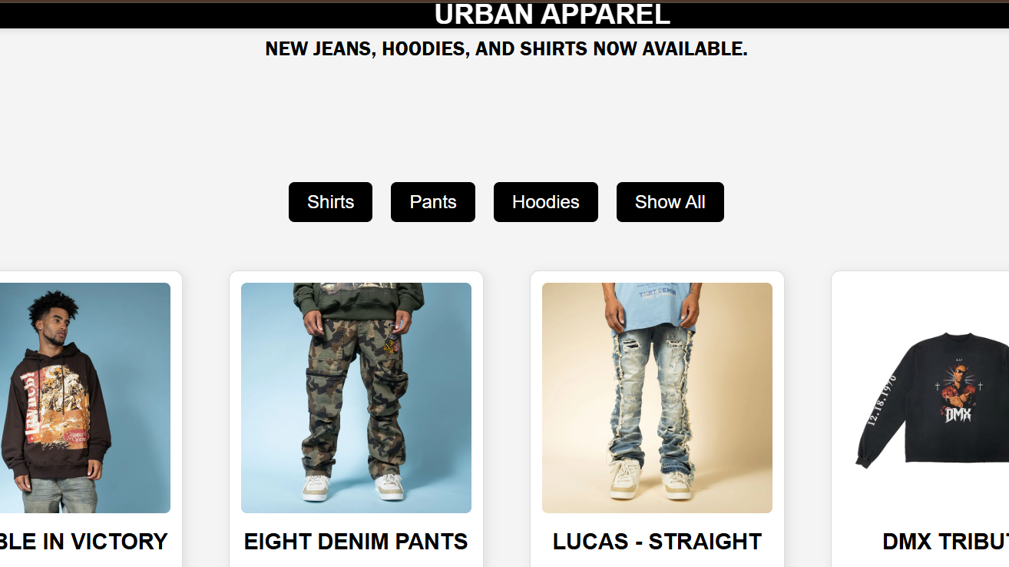
Key Design Elements - Home Page
Page Layout & Structure:
Header: Fixed to the top, includes navigation and cart icons.
Menu Sidebar: Appears when the menu button is clicked.
Carousel: Full-width banner images with fade transition.
Products Section: Displayed using flexbox, horizontally scrollable, with filters for shirts, pants, and hoodies.
Cart Sidebar: Fixed at the bottom-right of the page, with total price and checkout options.
Button and Interaction Design:
Buttons with a black background, hover effect to darken the button's background.

Slide 11
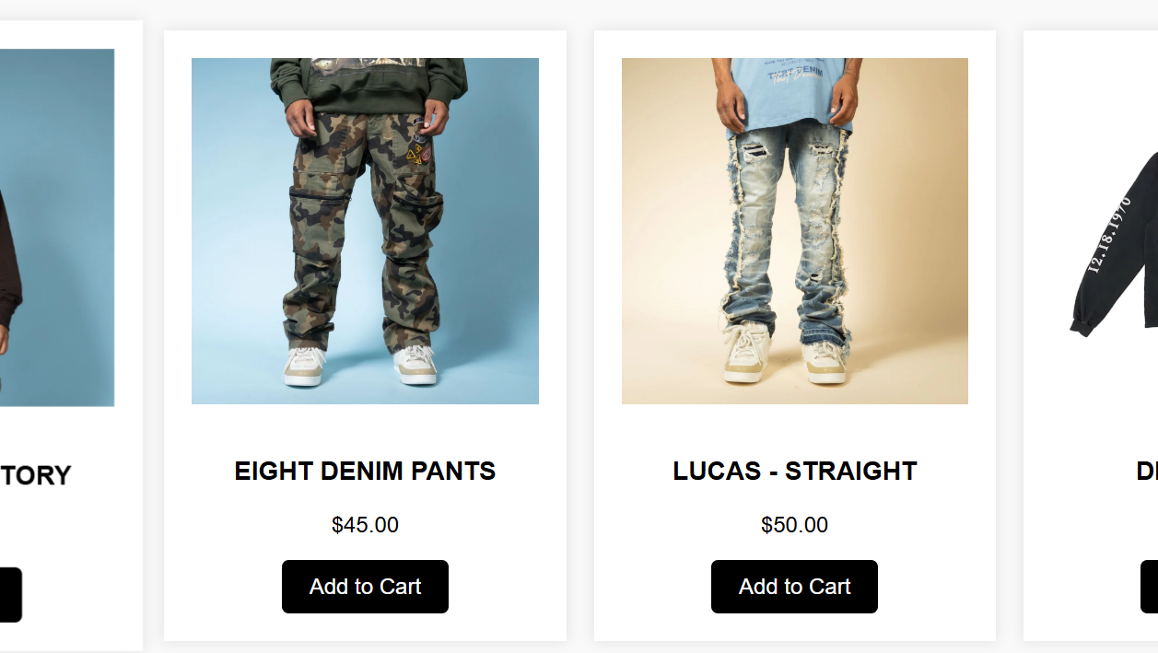
Key Design Elements - Products Page
Navigation:
Menu Button: Fixed to the top-left with black background.
Sidebar Menu: Appears when the menu button is clicked, slides in from the left.
Cart Button: Positioned at the top-right, accessible at all times.
Product Gallery:
Grid layout with 4 columns for product display.
Product Cards: White background, box shadow, and hover effect with a zoom feature.
Slideshow Banner:
Fade Transition for smooth image change.
Only one image visible at a time.
Product Filters:
Dropdown for selecting product categories.
Filter Button: Black background, hover effect to change the button’s shade.
Cart Sidebar:
Positioned on the right side of the page.
Cart Items: Displayed with spacing.
Clear Cart Button: Red background for contrast.

Slide 12
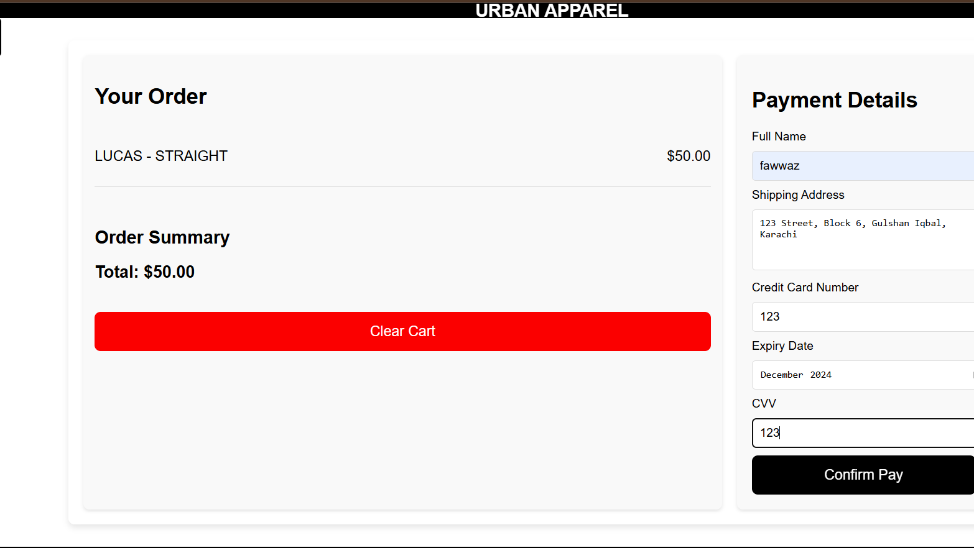
Key Design Elements - Checkout Page
Navigation:
Menu Button: Fixed top-left with smooth transition effect, black background with white text.
Sidebar Menu: Slides in from the left, features links to Home, Products, and Contact.
Cart Button: Positioned at the top-right.
Checkout Section:
Order Details: Shows the items in the cart with summary.
Payment Form: Collects user details and payment information.
Submit Button: Black background with white text.
Footer:
Black background with white text, centered at the bottom.
Buttons and Interactions:
Confirm Payment Button: Black background with white text.
Clear Cart Button: Red background to draw attention, hover effect for visual feedback.

Slide 13
Interactivity Features

Slide 14
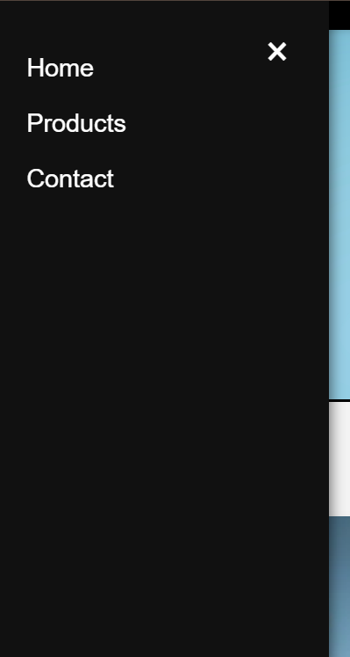
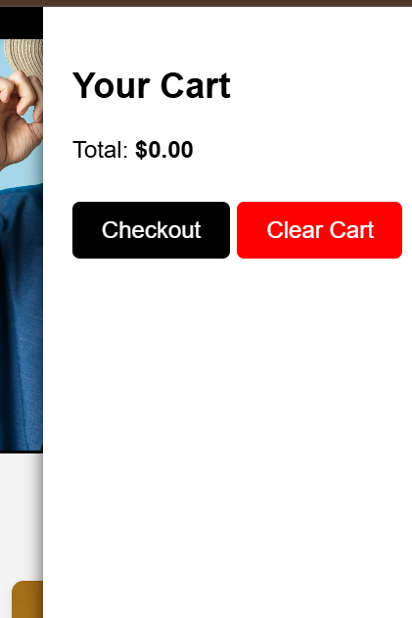
Common Functionality
LocalStorage Integration:
Cart data is saved in localStorage to persist items across pages.
Retrieves cart items on page load using JSON.parse(localStorage.getItem('cartItems')).
Cart Management:
Add to Cart: Adds selected products to the cart, and updates localStorage.
Cart Sidebar Toggle: Displays the cart when clicked and hides it with a smooth transition.
Clear Cart Button: Clears the cart both in the UI and localStorage.
Menu Sidebar Toggle:
Menu Button: Toggles the menu sidebar visibility.
Close Menu Button: Closes the sidebar, reverting the display.
Slideshow Functionality:
Automatically changes slides every 3 seconds, displaying one image at a time.

Slide 15
Interactivity Features - Home Page
Render Products:
Dynamically renders products from an array of objects.
Filter Products:
Filters products by category (e.g., shirts, pants, hoodies) using the filter button.
Cart Update:
Add to Cart: Adds items to the cart, updating the cart display and localStorage.
Cart Display: Updates cart items in the sidebar and displays the total price dynamically.
Event Listeners:
Cart Button: Opens the cart sidebar.
Close Cart Button: Closes the cart sidebar and shows the cart button again.
Product Item Hover Effect: Slight zoom effect when hovering over a product item, enhancing interactivity.

Slide 16
Interactivity Features - Products Page
Product Filtering:
Category Dropdown: Allows users to filter products based on category (e.g., hoodies, pants).
Filter Button: Applies the selected filter to the product list.
Cart Interaction:
Add to Cart Button: Adds products to the cart and updates the cart display dynamically.
Cart Sidebar Toggle: Opens and closes the cart sidebar with smooth transitions.
Product Gallery Display:
Grid Layout: Displays products in a grid system for better organization.

Slide 17
Interactivity Features - Checkout Page
Checkout Functionality:
Display Cart Items: Retrieves items from localStorage and displays them on the checkout page.
Calculate Total Price: Adds up the total price based on the cart items and updates the display.
Payment Form:
Submit Payment: Validates the payment form and processes the payment (mocked with a confirmation alert).
Clear Cart: Clears the cart both on the UI and in localStorage.
Confirm Payment Button: Confirms payment, clears the cart, and redirects the user to the home page upon successful transaction.
Navigation and Menu Interaction:
Menu Sidebar: Similar toggle functionality as the Home page, to open/close the sidebar.

Slide 18
Challenges and Solutions

Slide 19
Design and Responsiveness
Challenge:
Maintaining a sleek, modern design with a consistent black color scheme and responsive layout across all pages (Home, Products, and Contact Us) while integrating animations and interactive elements.
Solution:
Consistent CSS Framework:
Used a centralized CSS file with reusable classes for colors, fonts, and spacing.
The dark theme and hover/scroll animations were defined globally for uniformity.
Responsive Design:
Implemented a mobile-first design approach with CSS Grid and Flexbox for smooth layout adjustments across devices.
Media queries were added for fine-tuning responsiveness.
Testing:
Frequent testing on different devices and browsers to ensure consistent styling and behavior.

Slide 20
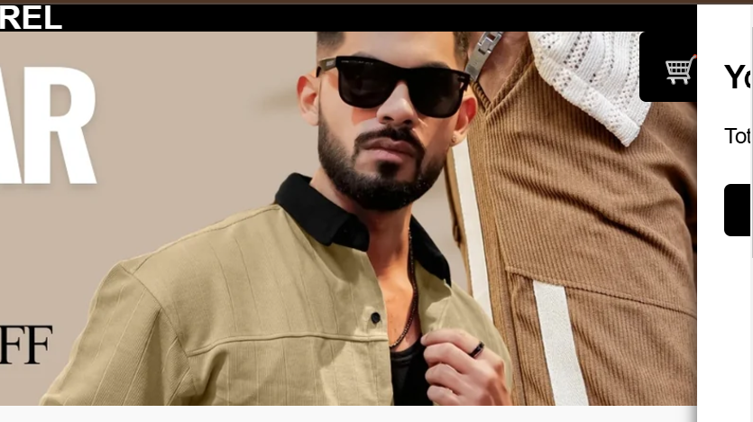
Animations and Interactivity
Challenge:
Implementing smooth, visually appealing animations for scrolling effects and hover transitions (e.g., changing product images on hover).
Solution:
CSS Transitions and Keyframes:
Used properties like transform, opacity, and transition to create smooth animations for scrolling and hover effects.
JavaScript Intersection Observer:
Utilized the Intersection Observer API to trigger animations when elements enter the viewport.
Optimization:
Minimized animation-related performance issues by using hardware-accelerated properties like transform and opacity instead of top or left.

Slide 21


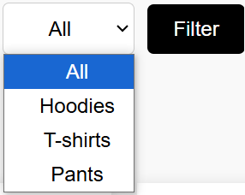
Functional Components
Challenge:
Creating functional, interactive components like the cart, filter system, and sidebar menu while ensuring smooth user interactions.
Solution:
Cart Functionality:
Built the cart system with JavaScript to enable users to add, remove, and update items dynamically.
Used event delegation for handling clicks on dynamically generated cart items.
Filter System:
Implemented a category-based filter system to dynamically show/hide products based on selected criteria.
Menu Animation:
Created the sidebar menu and cart panel with CSS transitions, adding smooth open/close animations using JavaScript.

Slide 22
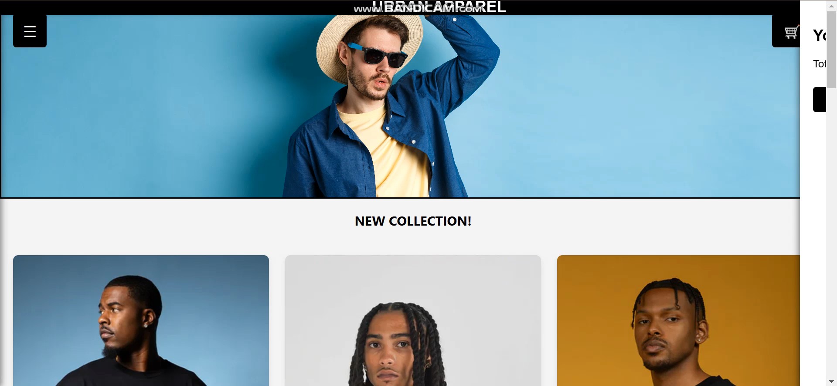

Slide 23
Image Handling and Banners
Challenge:
Developing an engaging slideshow banner that loops images smoothly without affecting responsiveness or slowing down the page.
Solution:
Image Transitions:
Used CSS keyframes for automatic image transitions, with JavaScript for user controls (e.g., next/previous buttons, pausing on hover).
Preloaded images to prevent flickering between slides.
Ensured responsiveness by setting image widths as percentages and using object-fit for proper scaling.
Challenge:
Uploading high-quality images for banners while ensuring fast loading times and seamless adaptation to screen sizes.
Solution:
Image Optimization:
Compressed images using tools like TinyPNG to reduce file sizes without compromising quality.
Used the background-size: cover; property for background images to maintain proportions and avoid distortion.
Responsiveness Testing:
Set height and width using percentage-based units for proper alignment and scaling across devices.
Challenge:
Making the banners clickable while ensuring the entire banner (not just text) redirects users to product pages.
Solution:
Wrapped each banner’s container in an <a> tag, ensuring the entire banner is clickable.
Verified functionality across different browsers for compatibility.

Slide 24
Thankyou
URBAN-APPAREL.CO

